Slide 1
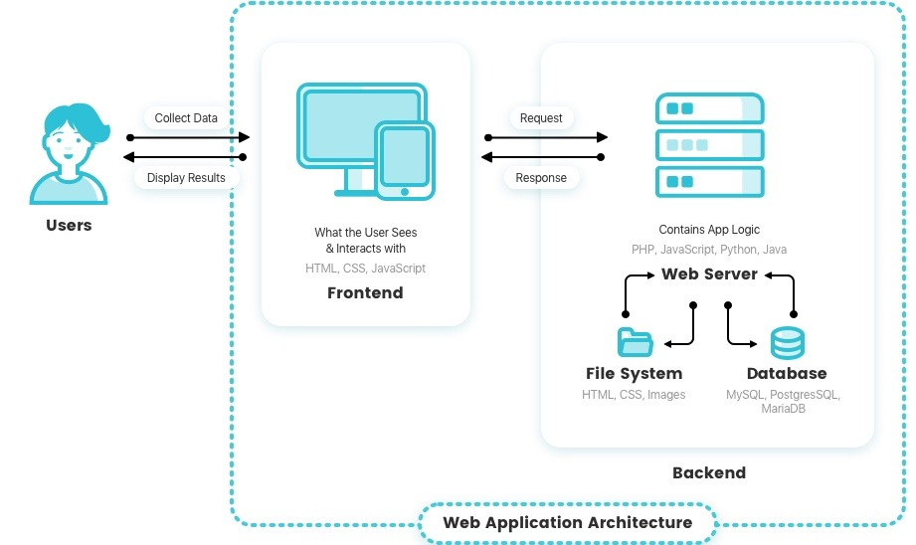
How Web Application Works?

Slide 2
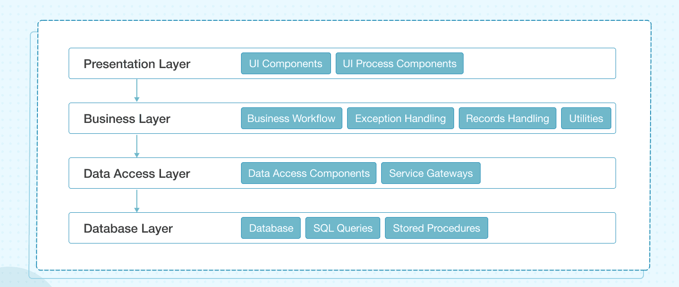
Layers of Web Application Architecture

Slide 3
Website v/s Web Application
Website
Website is a collection of related web pages
It can be consist of one page, two pages, and n number of pages.
A website provides visual and text content that users can view and read.
To view a website requires a browser(Chrome, Firefox).

Slide 4
Web Application
Web application is a piece of software that can be accessed by the browser.
A Browser is an application that is used to browse the internet.
Web application needs authentication.
The web application uses a combination of server-side scripts and client-side scripts to present information.

Slide 5
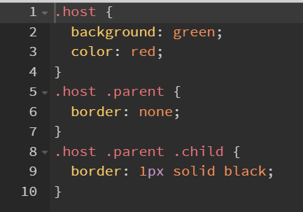
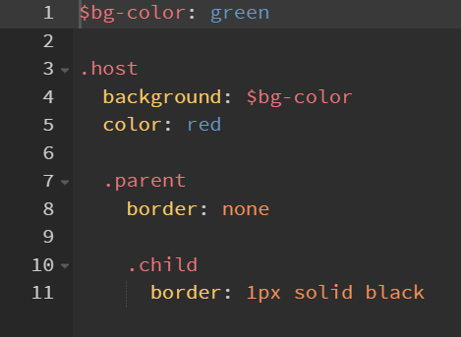
CSS v/s SASS

Slide 6
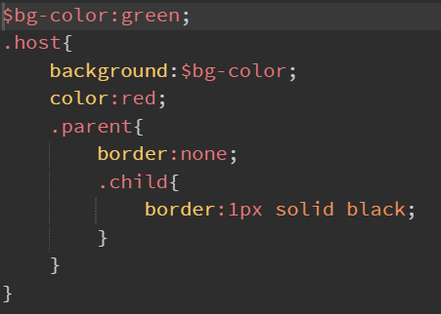
SCSS

Slide 7
Task Runners
A task runner basically runs commands for doing some specific tasks.
It compile your code from SCSS to CSS or TypeScript to JavaScript.
They also do things like copying files from location to location.
They minifying files for production.
Example: Gulp, Grunt

